Slide 1
Basis for Classical , Neoclassical and Anomalous Transports in Torus Plasmas
Lectures in ASIPP, 2011 and 2012, May~June
Heiji Sanuki
中国科学院等離子体物理研究所外籍特聘研究員（２００９）
and
Visiting Professor of ASIPP and SWIP

Slide 2
Basis for Classical, Neoclassical and Anomalous
Transports in Torus Plasmas
Heiji sanuki
Part 1:
Basis of transport theory, Classical Diffusion
Part2-1:
Neoclassical Transport in Tokamaks and Helical Systems
Part2-2:
Fluctuation Loss, Bohm, Gyro-Bohm Diffusion and Convective Loss etc.
Understanding of physics in transport process is one of the key issues associated with confinement improvement and/or
Device performance in fusion plasmas.
In this lecture, some fundamental equations and physics involved in transport process are briefly reviewed.

Slide 3
Fluctuation Loss, Bohm, Gyro-Bohm Diffusion
and
Zonal Flow and GAM
PartII-1 and II-2
References
Kenro Miyamoto: NIFS-Proc. 80, Chapt.10, pp157~pp187
Kenro Miyamoto: NIFS-Proc. 88, Chapt.7, pp76~pp81
App. E, pp328~341(in Japanese)
3) J. Q.Dong ,H.Sanuki and K.Itoh,PoP(2001),NF(2002,2003)
4) Zhe Gao , H.Sanuki, K.Itoh and J.Q.Dong, PoP(2003,2004,2005)
5) Zhe Gao, K.Itoh, H.Sanuki and J.Q.Dong,PoP(2006)
6) H.Sanuki and Jan Weiland(1979)
7) Jan Weiland ,H.Sanuki and C.S.Liu(1980)
8) Lots of references involved in this lectures

Slide 4
Topics (PartII-1)
(a)Diffusion caused by Ion Temperature Gradient(ITG)
modes ,Two cases, (1) mode overlapping and
(2) no overlapping (localized)
(b) Simulation Models for Turbulent Plasmas
(c) Gyro-Kinetic Particle Simulation Model for trapped
electron drift modes
(d) Gyro-Kinetic Particle Simulation Model for ITG Modes
(e) Full Orbit Particle Model
(f) Experimental Observations of Heat Diffusivity
(g) Brief View of Gyro-Kinetic and Gyro-Fluid Simulation of
ITG and ETG Modes
(h) Parameter Dependence of Critical Temperature Gradient
associated with Heat Conductivity

Slide 5
Topics(PartII-2)
(a)Topics on Zonal Flow and Geodesic Acoustic Mode(GAM)
(b) Hasegawa-Mima equation in turbulent plasmas
(c) Electromagnetic Drift wave Turbulence and Convective
Cell Formation( Weiland-Sanuki-Liu Model)
(d)Characteristics of Hasegawa-Mima Equation
(e) Zonal Flow Generation Mechanism
(f) Self-Regulation and Dynamics for Zonal Flow in Toroidal
Systems
(g) Overview of Recent Progress in Zonal Flow and GAM
Studies
(h) Eigenmode Behavior of GAM
(i) Experimental Observations in EAST and other Tokamaks

Slide 6
PartII-1

Slide 7
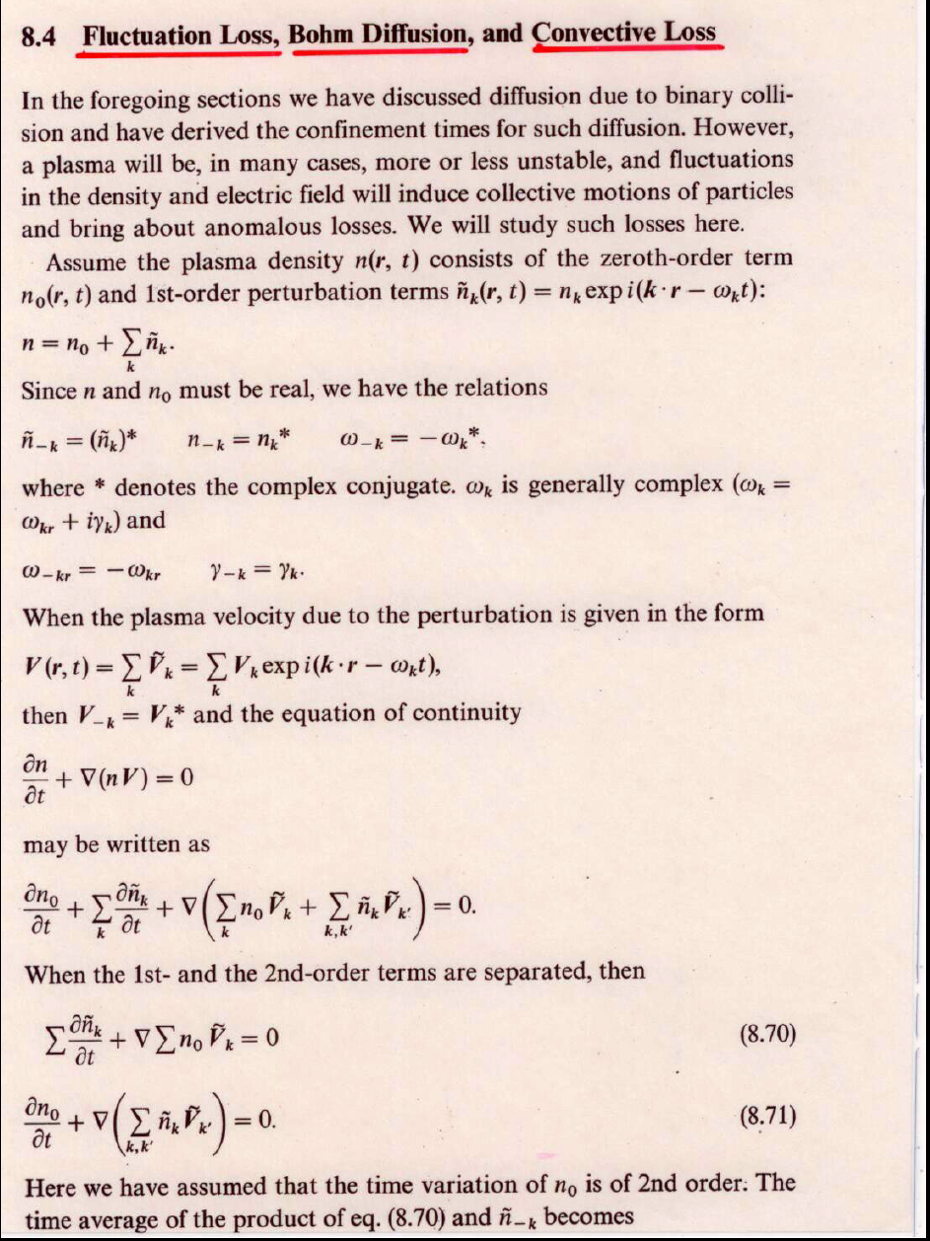
From K.Miyamoto

Slide 8
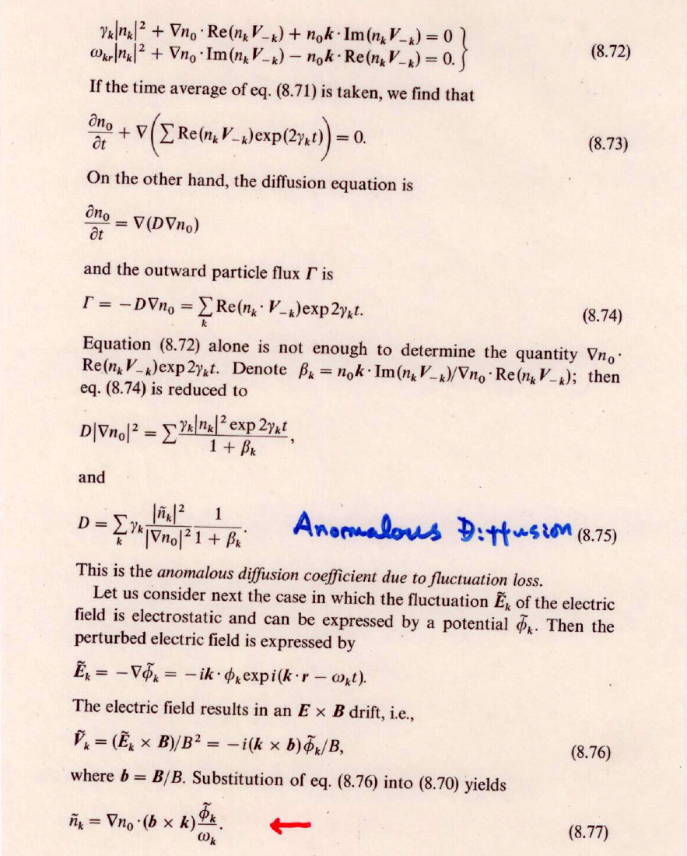

Slide 9
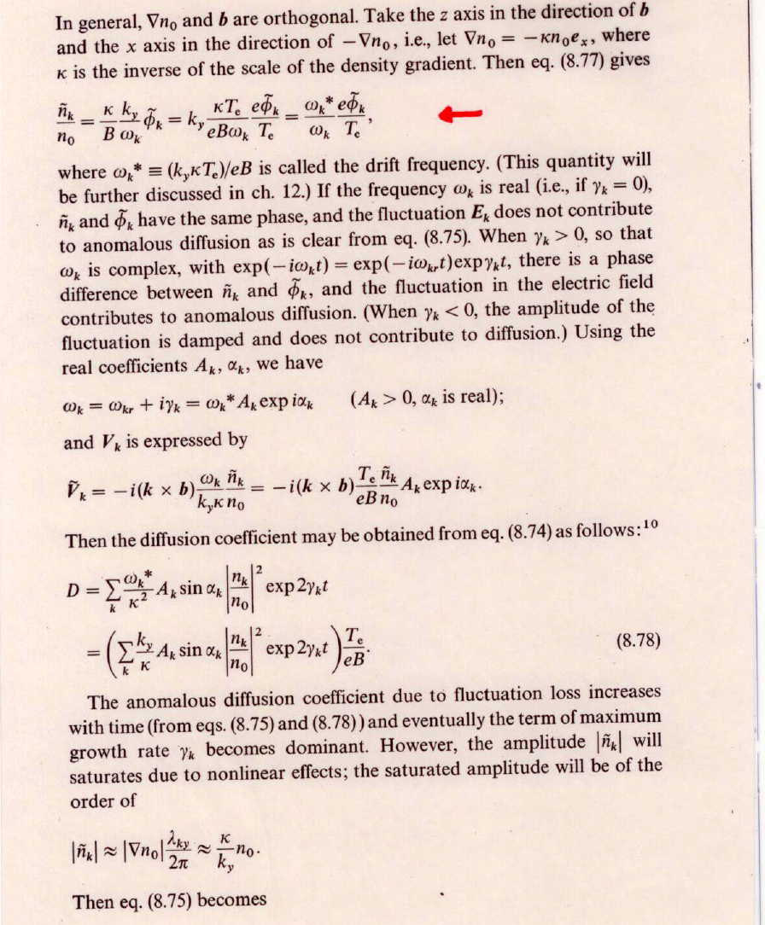
Mixing Length Theory

Slide 10
Bohm, Gyro-Bohm Diffusion
Bohm Diffusion
In saturation level of turbulence,
Bohm Diffusion Coefficient

Slide 11
Example: Diffusion caused by ITG modes
References:
S. Hamaguchi and W. Horton, PF B4,319(1992)
W .Horton et al., PF 21, 1366(1978)
F. Romanelli and F. Zonca, PF B5,4081(1993)
Y. Kishimoto et al., 6th IAEA vol.2 581(1997)
Mode fluctuation potential
qR: connection length

Slide 12
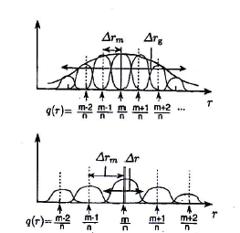
Example: Diffusion caused by ITG modes
(continued)
Case1: mode overlapping
Case2: no overlapping(localized)

Slide 13
Example: Diffusion caused by ITG modes
(continued)
Case1: mode overlapping(ITG)
(Bohm DiffusionType)
Case2: no overlapping ITG(weak shear configuration )
(Gyro-Bohm DiffusionType)
Note: Diffusion is small around minimum q in negative shear configurations

Slide 14
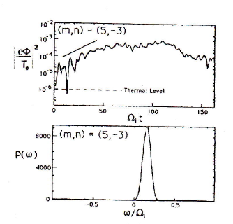
Simulation Models for Turbulent Plasmas
１）Gyro-Kinetic Particle Simulation Model ( W.W.Lee: PF 26,556
(1983))
Example1: “Trapped Electron Drift Mode ( R.D. Sydora: PF B2,
1455(1990))
For given parameters:
#Time evolution of Intensity of (m,n)=(5,3) mode
# Relation between spectrum and frequency
Saturation intensity
Growth rate and mode frequency are in good
agreement with linear mode analysis

Slide 15
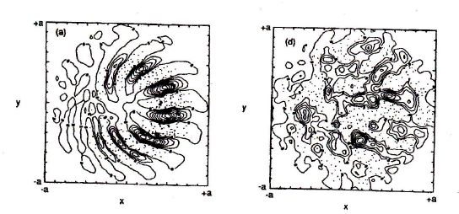
Simulation Models for Turbulent Plasmas(continued)
１）Gyro-Kinetic Particle Simulation Model ( W.W.Lee: PF 26,556
(1983))
Example2: “ITG mode ( S.E. Parker et al.: PRL 71,2042(1993))
δf/f method is applied, adiabaticity is assumed for
electrons
Electrostatic potential in poloidal cross section at both linear
and nonlinear saturation levels
Linear
Nonlinear

Slide 16
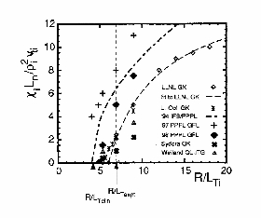
Experimental Observations of Heat Diffusivity (continued)
Gyrokinetic and gyrofluid simulations of ITG and ETG models
#A.M.Dimits et al. Phys. Plasmas 7(2000)969
From the gyrofluid code using 1994, an improved 1998 gyrofluid closer,
the 1994 IFS-PPPL model, the LLNL and U.Colorad flux-tube and UCLA (Sydora)
global gyrokinetic codes, and the MMM model (Weiland QL-ITG) for the DIII-D Base case.
Good fit scaling to LLNL gyrokinetic results
Offset linear dependence

Slide 17
Parameter Dependence of Critical Temperature Gradient
Algebrac formula for critical gradient are proposed associated with electron anomalous transport;
Jenko et al.,PoP(2001), Ryter,PRL(2001), Dong et al.,NF(2003),
many other papers
Critical gradients of the SWITG modes in wide parameter regions are evaluated to discuss the possibility of the SWITG instability as a possible candidate to explain anomalous transport( Zhe Gao, H. Sanuki, K. Itoh and J. Q. Dong)
(see, SWITG and SWETG PoP(2005) )
The scaling of the critical gradient with respect to temperature ratio, toroidicity, magnetic shear and safety factor are obtianed
( 19th ICNSP and 7th APPTC conference in Nara(July, 2005))

Slide 18
Parameter Dependence of Critical Temperature Gradient(continued)
(J.Q.Dong, G.Jian, A.K.Wang, H.Sanuki and K.Itoh, NF43(2003)1183)
ETG instability
Increasing temperature ratio,
(up to about 3)
is in favor of suppression of modes due to raising TG critical
and dropping coefficient between maximam growth rate and
derivation of TG from critical TG
Important comment from view point of control of
confinement improvement

Slide 19
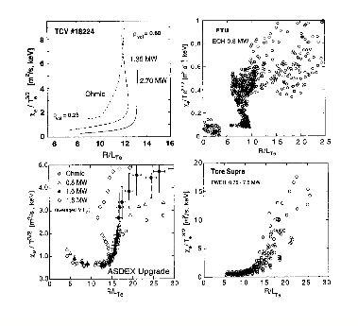
Experimental Observations of heat diffusivity
# Ion thermal transport could be reduced to neoclassical level
with Internal Transport Barrier(ITB’s) in DIII-D
# Electron ITB’s are observed in JET tokamak ECH dominant
discharges with
# ETG driven insta.
ECH experiments in typical
Tokamaks(ASDEX Upgrade,RTP,
FTU, TCV,etc.)
All four machines clearly show
a strong increase of electron
transport above a threshold
in
Offset Linear Dependence

Slide 20
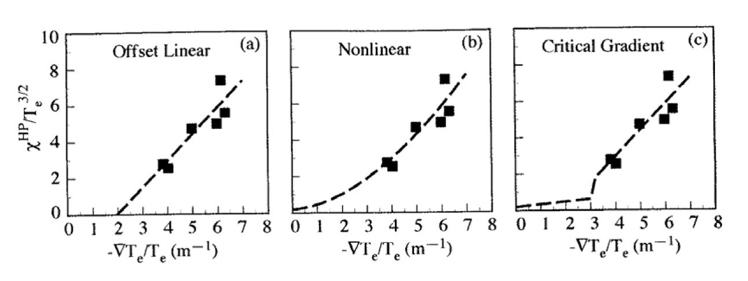
Experimental Observations in DIII-D
Experiment employed off-axis ECH heating to change local value of
Heat Pulse Diffusivity Model is proposed
JET ECH
Experiment
# No clear evidence of an inverse critical scale length on heat
diffusivity was observed in DIII-D experiments
# More improved theory and experimental fine data are needed

Slide 21
Simulation Models for Turbulent Plasmas
2）Full Orbit Particle Model:
References:
1)R.W.Hockney and J.W.Eastwood,” Coumputer
Simulation using Particles”, MacGraw-Hill, New York(1981)
This model is characterized by introducing “ Super-particle” and “Shaping Factor” and study wave phenomena with long wavelength
2)H. Naitou: J.Plasma Fusion Res. 74.470(1998)
Some limitations:
# Short wavelength modes are hardly studied
# CPU time is huge, for

Slide 22
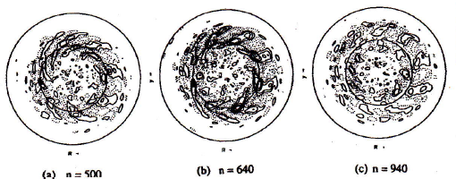
Simulation Models for Turbulent Plasmas(continued)
2）Full Orbit Particle Model:
“Toroidal Particle Code(TPC)”
# Study electrostatic turbulence, excluding electromagnetic effect
# Using Poisson equation instead of Maxwell equations
References:
1) M.J.LeBrun et al., PF B5,752(1993)
2)Y. Kishimoto et al. Plasma Phys. Contr. Fusion 40, A&&#(1998)
“ ITG mode in tokamak”, electrons are adiabatic fluid ( assumed)
Electrostatic Potential plot
in negative shear tokamak
“Discontinuity around
minimum -q surface in
qusi-stationary state”

Slide 23
Ｔopics on Zonal Flow(Convective cell)
Hasegawa-Mima equation in turbulent Plasmas
References
A. Hasegawa and K. Mima, PF 21,87(1978)
A.Hasegawa, C.G. Maclennan and Y. Kodama, PF22,2122(1979)
Assumpitons involved in Model:
1)Continuity eq. for ions, 2)ion inertia effect parallel to B is neglected, 3) ions: cold, 4) electron : Boltzmann distribution,
4) ordering:

Slide 24
Ｔopics on Zonal Flow(Convective cell)
(continued1)
Derivation of Hasegawa-Mima eq. in turbulent Plasmas
E×B drift Polarization drift

Slide 25
Ｔopics on Zonal Flow(Convective cell)
(continued2)
Derivation of Hasegawa-Mima eq. in turbulent Plasmas
(Hasegawa-Mima-Charney equation)
Density gradient is negligible small
(Hasegawa-Mima equation) 長谷川―三間的式
Note: This equation has two conservations
“Energy conservation” and “vorticity conservation”

Slide 26
Electromagnetic Drift Wave turbulence and Convective Cell Formation(1)
#Convective cell formations( electrostatic ) have attracted much
interest from turbulence and related anomalous transport
in 1970s and 1980s
#Electrostatic convective cell formation based on nonlinear drift
wave model (Hasegawa-Mima eq.)(1978)
# Electromagnetic convective cell formation based on nonlinear
drift Alfven wave model ( Sanuki-Weiland model(J. Plasma Phys.(1980))
Viscosity term

Slide 27
Characteristics of Hasegawa-Mima Equation
Hasegawa-Mima eq. in turbulent Plasmas
(Hasegawa-Mima-Charney equation)
Non-dimensional form

Slide 28
Characteristics of Hasegawa-Mima Equation
(continued)

Slide 29
Characteristics of Hasegawa-Mima Equation
(continued2)

Slide 30
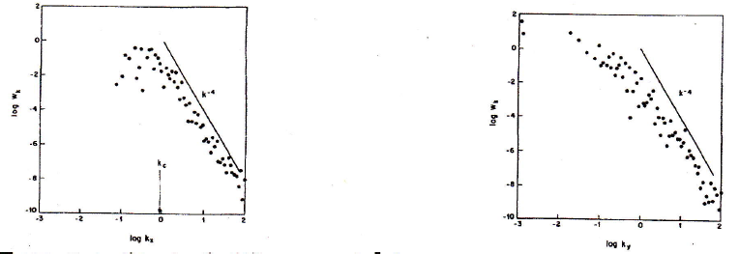
Characteristics of Hasegawa-Mima Equation
(continued3)
Linear-nonlinear
term are comparable
at k-critical
Zonal Flow in Drift
Turbulnce
kx- dependence
ky- dependence

Slide 31
Characteristics of Hasegawa-Mima Equation
(continued4)
n(k,x,t): Power density of high frequency spectrum of

Slide 32
Characteristics of Hasegawa-Mima Equation
(continued5)

Slide 33
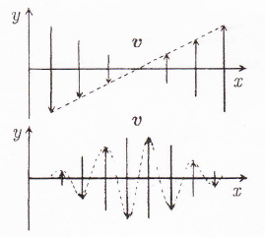
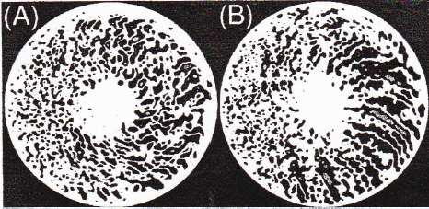
Zonal Flow Generation
Recent development in both theory and simulation leads physics
involved in zonal flow mechanism more understandable
References:
Z. Lin et al., Science 281,1835(1998)
A.I. Smolyakov et al. PRL 84,491(2000)
P.N. Guzdar , R.G. Kleva and Liu Chen, Phys. Plasmas 87,459(2001)
Gyro-kinetic particle simulation(Lin et al.)
Shear flow
Zonal flow
(A)shearing effect by zonal flow, (B) no shearing effect

Slide 34
Zonal Flow Generation
(continued1)

Slide 35
Zonal Flow Generation (continued2)
Zonal flow excitation by drift wave
For

Slide 36
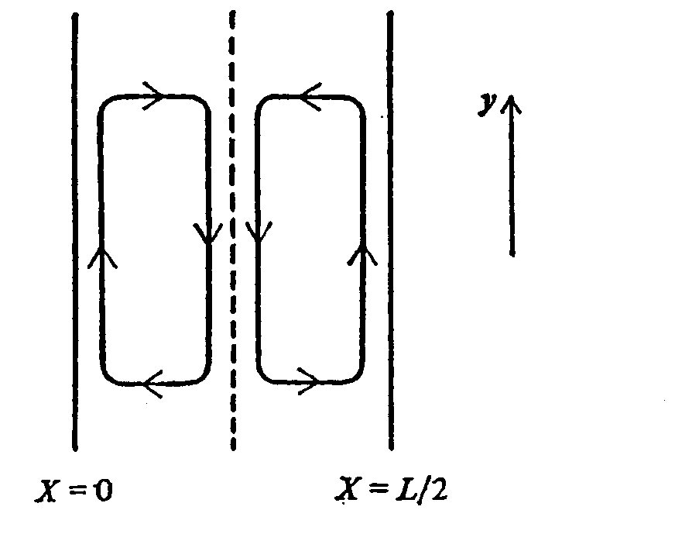
Electromagnetic Drift Wave Turbulence and Convective Cell Formation(4)
Coefficients of NS Equation
Following the theory by H. Sanuki et al.(1972)
Modulational insta. condition
Elongated structure of Convective cell
J.Weiland, H.Sanuki and C.S.Liu, PoF(1980)

Slide 37
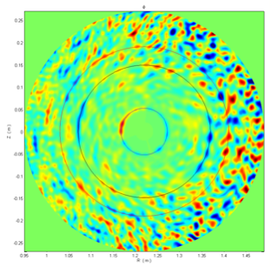
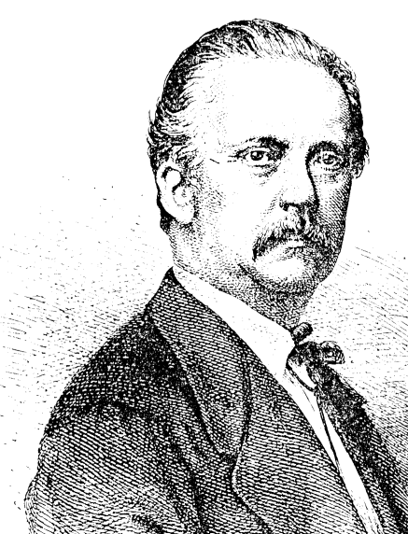
Discovery of new truths by studying the past through scrutiny of the old(温故知新)
Vertex(Convective cell,zonal) Motions in Nature
Typhoon, Giant Red Spot in
Jupiter (Zonal flow)、
El Nino, La Nina、etc
Review of vortics
International J. of Fusion Energy
(1977-1985, particularly, 77~78, F1R26)
# Hermann Helmholtz(1858)(general)
# Winston H. Bostick (Vortex Ring)
# D.R.Wells and P.Ziajka (Theory and Experiment) , others
Zonal Flow
What kind of dynamics determines Structure of Vortices(2D) ？
（unsophisticated question）

Slide 38
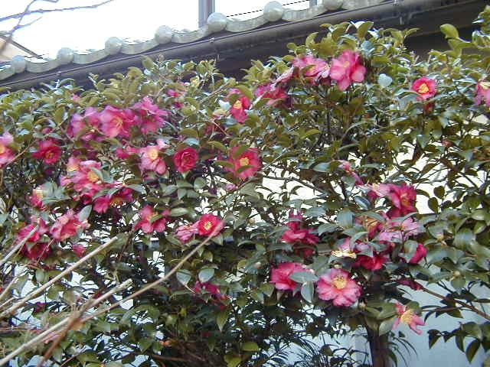
謝謝清聴
落紅不是無情物
化作春泥更護花
（龚自珍 己亥雑詩）
再見
Notes:
38

Slide 39
ACKNOWLEDGMENTS
I would like to acknowledge many collaborators and friends for their continuous and fruitful discussions. This visit is supported
by Prof. Li Jiangang and the Chinese Academy of Sciences、Visiting Professor for Senior International Scientists(2009 fiscal year) ,and also supported by Prof. Liu Yong as a guest professor of SWIP.
The present topic is also partially discussed under close collaborations with NIFS( K. Itoh, A. Fujisawa et al.),Tsinghua University (Gao Zhe et al.) and SWIP ( Dong Jiaqi ,Wang Aike
et al.)
Finally I would like to acknowledge all friends and staffs,
students who take care of lots of arrangements of my visiting ASIPP since my first visit, 1991.
Notes:
39

